Slide 1

Tutorial 11: kaiju classification
Alejandro Mateo, Harshil Patel, & Adam Waleed

Slide 2

Kaiju algorithm
Kaiju is a program for fast taxonomic classification
Based on sequence comparison to reference database
Each sequencing read is assigned to a taxon in the NCBI taxonomy
Done by comparing the input sequence to reference database
Kaiju uses protein-level classification
Results in higher sensitivity compared to nucleotide-based comparison
Reads are translated into amino acid sequences, searched in the database using modified backward search with memory-efficient implementation of Burrows-Wheeler Transform
Finds maximum exact matches (MEMs)
Optionally allows mismatches in protein alignment
The algorithm is very fast, a search can process up to millions of reads per minute using, for example only 10 GB of RAM with a reference database comprising 4812 complete microbial genomes
The algorithm is open source with code and web server available at http://kaiju.binf.ku.dk

Slide 3
Burrows-wheeler transform
Kaiju employs a search strategy, which finds maximal exact matching substrings between query and database using a modified version of the backwards search algorithm in the BWT.
BWT is a text transformation that converts the reference sequence database into an easily searchable representation.
Allows for exact string matching between a query sequence and the database in time proportional to the length of the query
The remarkable thing about BWT is that this particular transform is reversible with minimal data overhead, so given the BWT of a string, the string can be reconstructed.

Slide 4
Burrows-wheeler transform steps
Take the word “banana$” for example.
Step 1: Form all the cyclic rotations of the given text.
banana$
$ b $banana
a a a$banan
Cyclic rotations ----------> na$bana
n n ana$ban
a nana$ba
anana$b

Slide 5
Burrows-wheeler transform steps
Step 2: The next step is to sort the rotations alphabetically. The ‘$’ sign is viewed as first letter alphabetically, even before ‘a’.
banana$ $banana
$banana a$banan
a$banan Sorting ana$ban
na$bana ----------> anana$b
ana$ban alphabetically banana$
nana$ba na$bana
anana$b nana$ba

Slide 6
Burrows-wheeler transform steps
Step 3: The last column is what we output as BWT.
banana$ $banana
$banana a$banan
a$banan Sorting ana$ban
na$bana ----------> anana$b
ana$ban alphabetically banana$
nana$ba na$bana
anana$b nana$ba
Output: BWT(banana$) = annb$aa

Slide 7
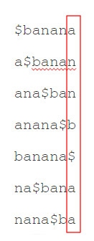
importance of bwt last column
Why last column is considered BWT?
The last column has a better symbol clustering than any other columns.
If we only have BWT of our string, we can recover the rest of the cyclic rotations entirely.
BWT(X) is easier to compress than X.

Slide 8
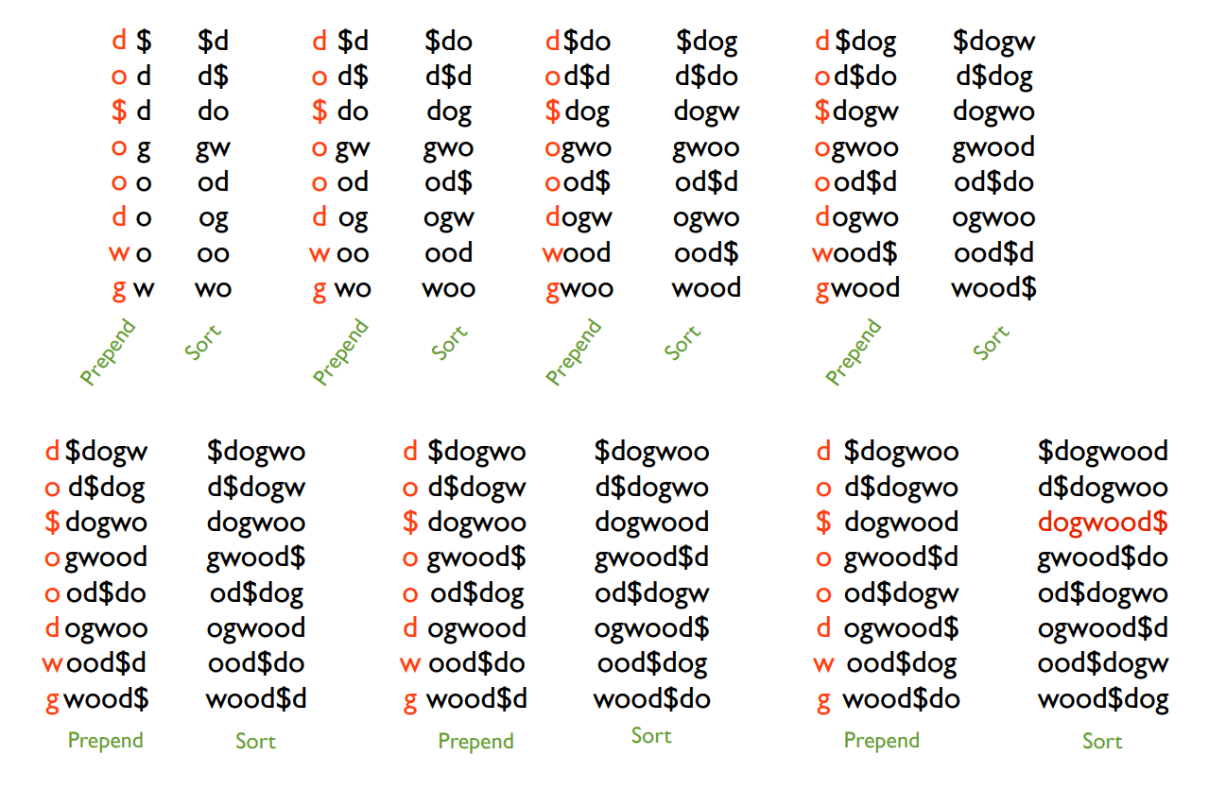
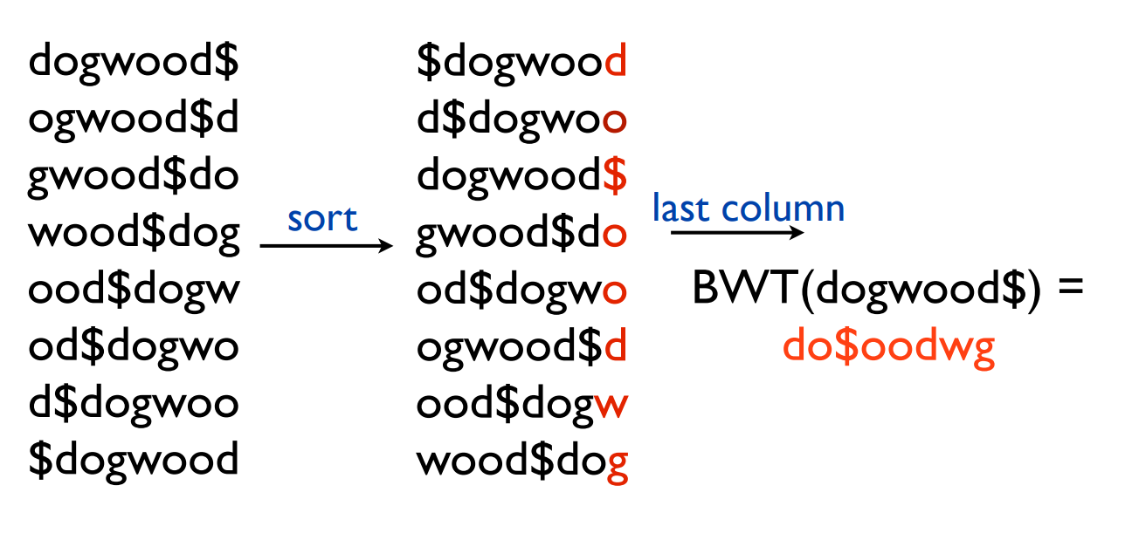
Bwt example (Recovering the string)

Slide 9
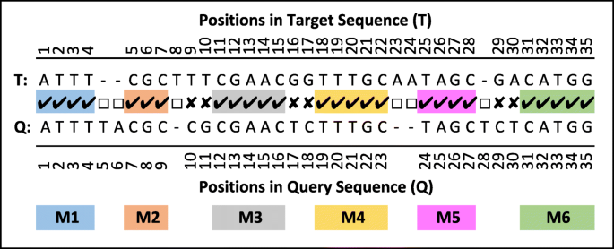
mem
Maximum Exact Matches:
Exact matches between two strings that cannot be extended in either direction towards the beginning or end of two strings without allowing for a mismatch.
Kaiju’s MEM mode has lower sensitivity compared with Greedy modes in all cases, because it only searches for exact matches, which is especially visible in short reads.

Slide 10
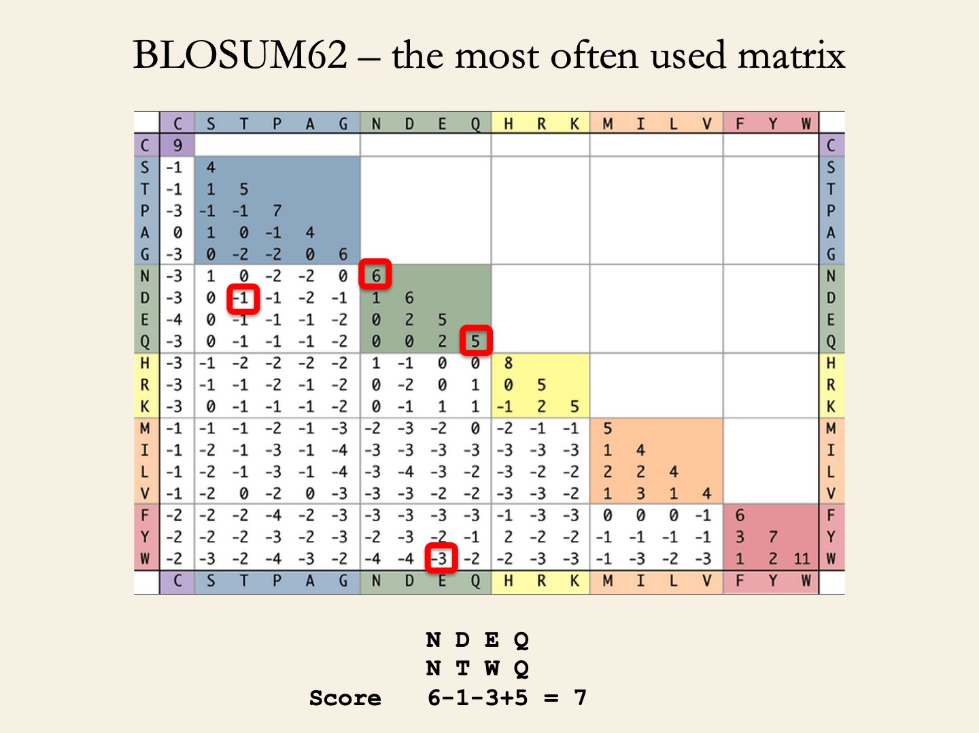
greedy
Greedy Run:
BLOSUM62 Score (BLOcks SUbstitution Matrix) - is a substitution matrix used for sequence alignment of proteins.
Each value in the matrix is calculated by dividing the frequency of occurrence of the amino acid pair in the BLOCKS database, clustered at the 62% level, divided by the probability that the same two amino acids might align by chance. The ratio is then converted to a logarithm and expressed as a log odds score.
A score of zero → frequency with which a given two amino acids were found aligned in the database was as expected by chance
Positive score → indicates that the alignment was found more often than by chance
Negative score → indicates that the alignment was found less often than by chance.

Slide 11
Inputs & outputs
Inputs:
Input files containing the (single-end or paired-end) reads can either be in FASTA or FASTQ format.
Outputs:
Kaiju outputs one line for each read (or read pair), containing
the read name
the NCBI taxon identifier of the assigned taxon
the length or score of the match.
Optionally, Kaiju can also produce a summary file with the number of reads assigned per taxon, which can be loaded into Krona for interactive visualization.

Slide 12
Kaiju vs k-mer algorithms
Usage of genomic k-mers has some shortcomings: the data structures for storing the k-mers for a fast lookup require a lot of RAM, so some programs typically restrict their reference database to a set of completely assembled reference genomes.
Kaiju only requires a comparatively small amount of RAM, allowing it to use the entire microbial subset of the nr protein database, while having similar or faster runtime compared with the fastest k-mer classifiers.
Kaiju has a much higher sensitivity compared with a classification based on k-mer comparison, while maintaining a similar precision.
Kaiju could classify many more reads in ten randomly selected metagenomes from a wide range of microbial habitats.

Slide 13
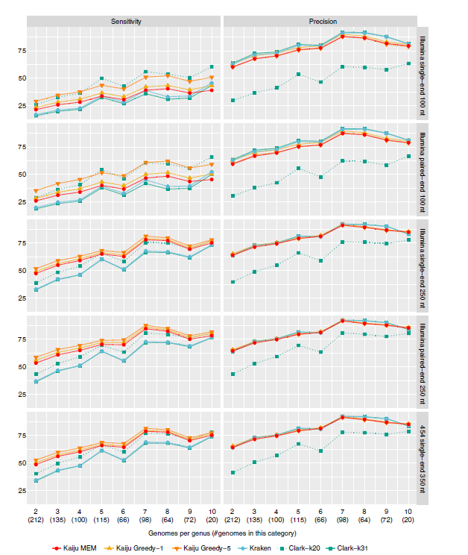
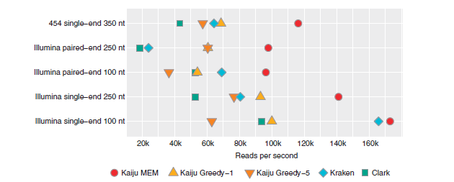
Kaiju vs k-mer algorithms

Slide 14
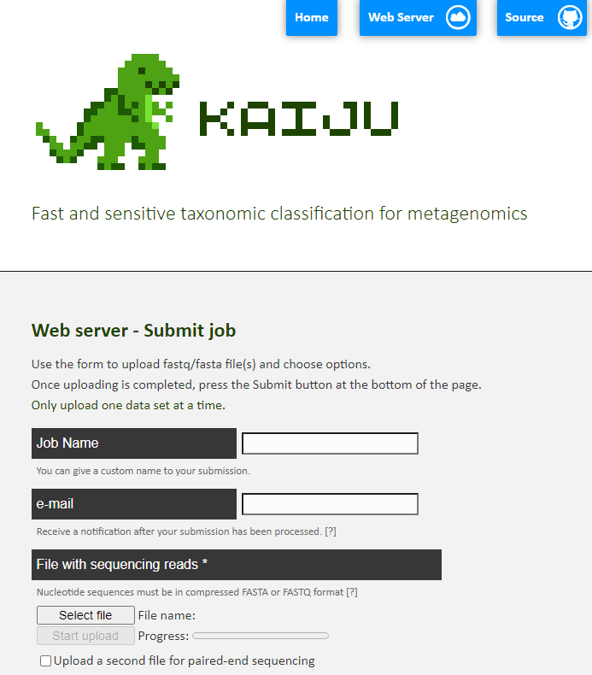
How to use kaiju
Name
Email
Input File
FASTA or FASTQ

Slide 15
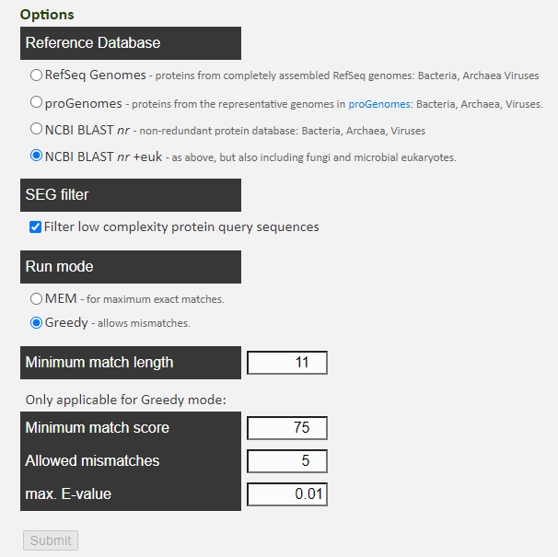
How to use kaiju
Reference Database
RefSeq Genomes (proteins from assembled genomes: Bacteria, Archaea Viruses)
NCBI BLAST nr + euk (protein database: Bacteria, Archaea, Viruses, + fungi & microbial eukaryotes
SEG Filter
Low complexity sequences are filtered out to mitigate chance of artificial hits
Minimum Match Length
Criteria for sequence comparison
Minimum Match Score
Fragments ranked by BLOSUM62 score so minimum score allows avoidance of random matches
Allowed Mismatches
In input data vs database sequence
Max E-Value
Number of hits expected to see by chance

Slide 16
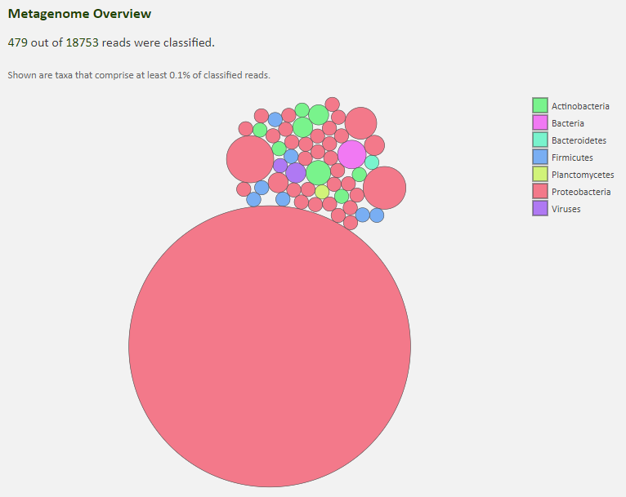
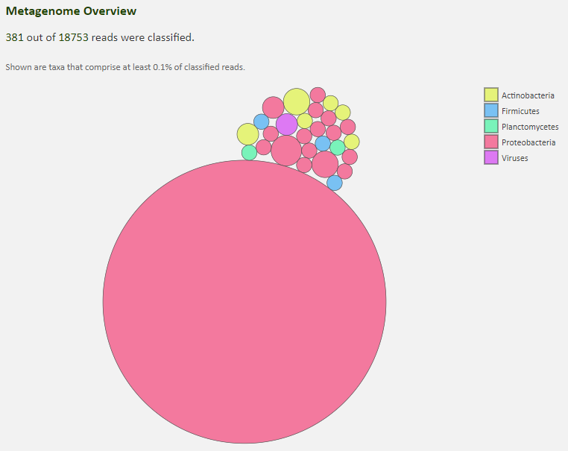
Refseq genomes – mem vs greedy
Majority of the reads classified under Proteobacteria (phylum)
In both MEM & Greedy
MEM classified into more phylum

Slide 17
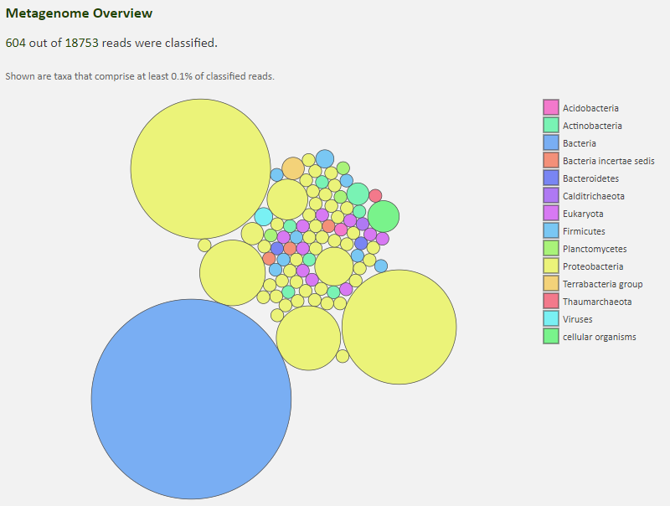
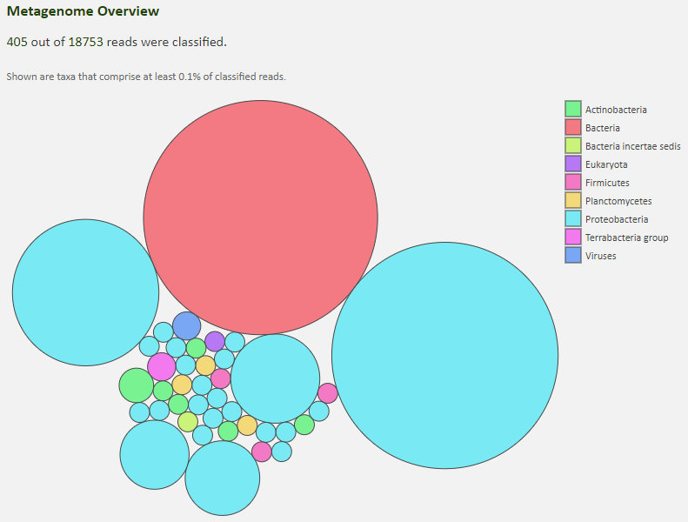
Ncbi blast nr+euk - mem/greedy
Majority of the reads classified under Proteobacteria (phylum)
In both MEM & Greedy
MEM classified into more phylum

Slide 18
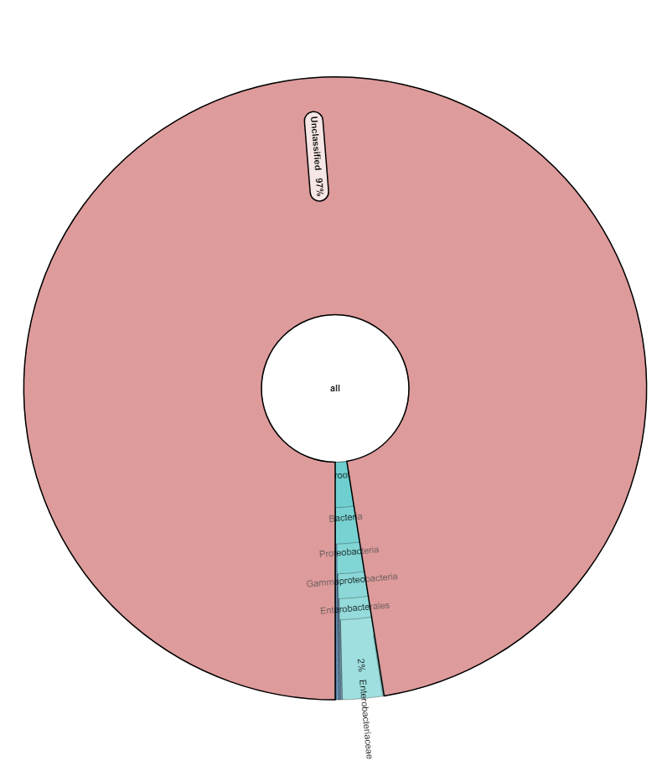
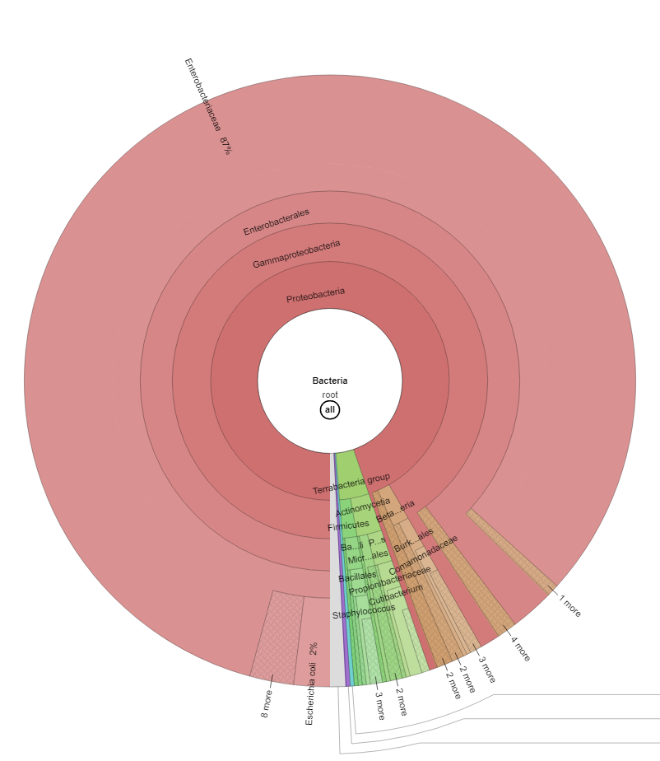
Krona – refseq genomes/mem
Krona is a visualization tool for taxonomic classification
Shows breakdown of taxonomy all the way down to species level

Slide 19
results
 | RefSeq – MEM | RefSeq – Greedy | NCBI Blast nr+euk - MEM | NCBI Blast nr+euk - Greedy
Classified Reads | 479 | 381 | 604 | 405
Classified % | 3% | 2% | 3% | 2%
Groups | 7 | 5 | 14 | 9

Slide 20
Results
Using NCBI database provides more classified reads compared to RefSeq
NCBI classification is more thorough compared to RefSeq
MEM provided more classified reads compared to Greedy in both databases
By using protein-level classification Kaiju can achieve comparable sensitivity while utilizing less memory and time

